Slide 1

Experiencing M I S
Ninth Edition
Chapter Extension 10
Collaborative Information Systems for Student Projects
Slides in this presentation contain hyperlinks. JAWS users should be able to get a list of links by using INSERT+F7
Copyright © 2021, 2019, 2017 Pearson Education, Inc. All Rights Reserved
Notes:
If this PowerPoint presentation contains mathematical equations, you may need to check that your computer has the following installed:
1) MathType Plugin
2) Math Player (free versions available)
3) NVDA Reader (free versions available)

Slide 2
Study Questions
CE 10-1 What are the I S requirements for student project collaborations?
CE 10-2 How can you use collaboration tools to improve team communication?
CE 10-3 How can you use collaboration tools to share content?
CE 10-4 How can you use collaboration tools to manage tasks?
CE 10-5 Which collaboration information system is right for your team?

Slide 3
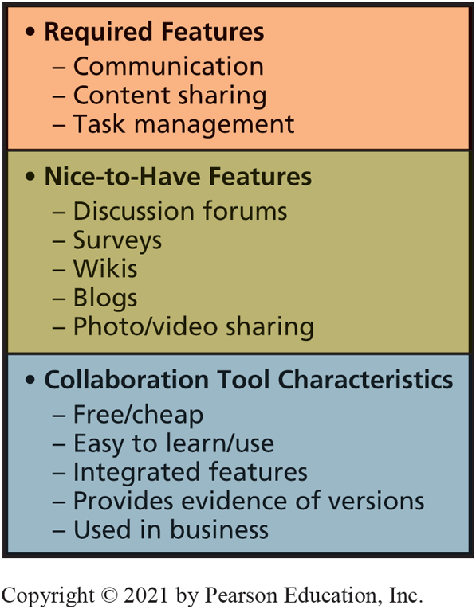
Student-Project Collaboration I S Requirements Summary
CE 10-1 What are the IS requirements for student project collaborations?
Figure C E 10-1 Student-Project Collaboration I S Requirements Summary
Notes:
Face-to-face meetings are difficult to schedule and invariably someone can’t be on campus, or is stuck in traffic, or misses the bus, or whatever.

Slide 4
Collaboration Tools
CE 10-2 How can you use collaboration tools to improve team communication?
Enable iteration and feedback
Share documents, spreadsheets, presentations, and work-product data
Share project metadata (tasks, schedules, calendars, budgets)
Application use and how team shares data depend on type of content

Slide 5
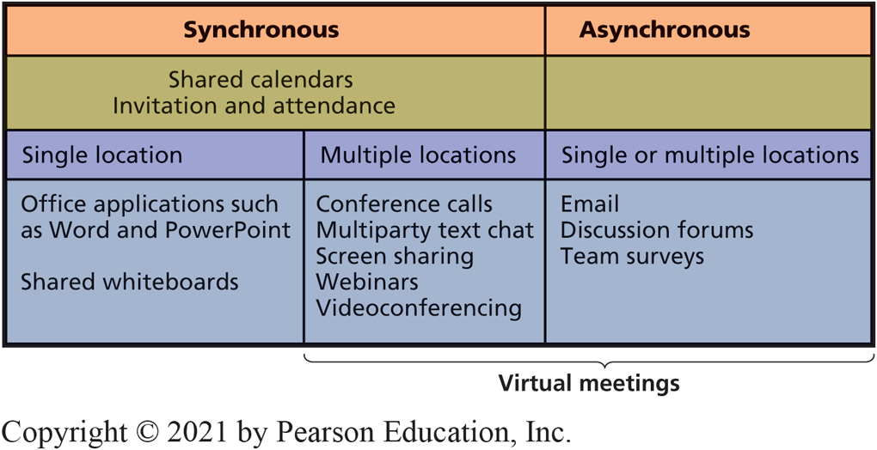
Collaboration Tools to Improve Team Communication
CE 10-2 How can you use collaboration tools to improve team communication?
Figure C E 10-2 Collaboration Tools for Communication
Notes:
Enabling and supporting team communication are major functions of collaboration systems. Tools depend upon the ways a team needs or wants to communicate.
For most student projects, forego face-to-face meetings. Instead, learn to use asynchronous virtual meetings.

Slide 6
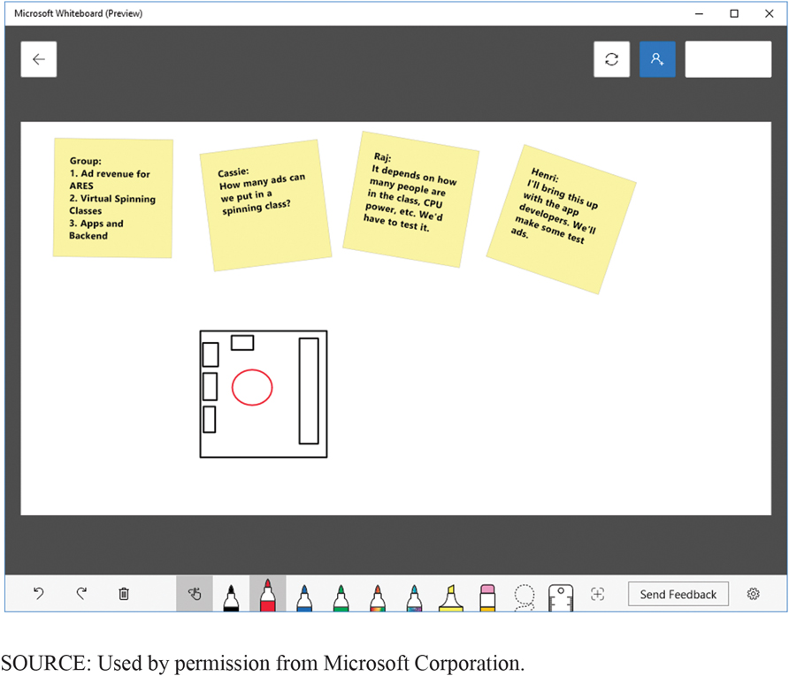
Microsoft Whiteboard Showing Simultaneous Contributions
CE 10-2 How can you use collaboration tools to improve team communication?
Figure C E 10-3 Microsoft Whiteboard Showing Simultaneous Contributions
Notes:
Skype for Business
Whiteboards enable users to view same whiteboard, application, or other display.
Team members can type, write, and draw simultaneously.
Enables more idea consideration.

Slide 7
Virtual Meetings
CE 10-2 How can you use collaboration tools to improve team communication?
Multiparty text chat
Microsoft Skype for Business, Google Hangouts.
Search Google for “multiparty text chat.”
Screen-sharing applications.
Webinar (webex.com).
Videoconferencing
Google Hangouts, WebEx, Skype for Business.
Notes:
Webinar is a virtual meeting in which attendees view one of the attendees’ computer screens for a more formal and organized presentation. WebEx (www.webex.com) Video and audio recordings are useful for asynchronous communication of important discussions, presentations, and training new employees.

Slide 8
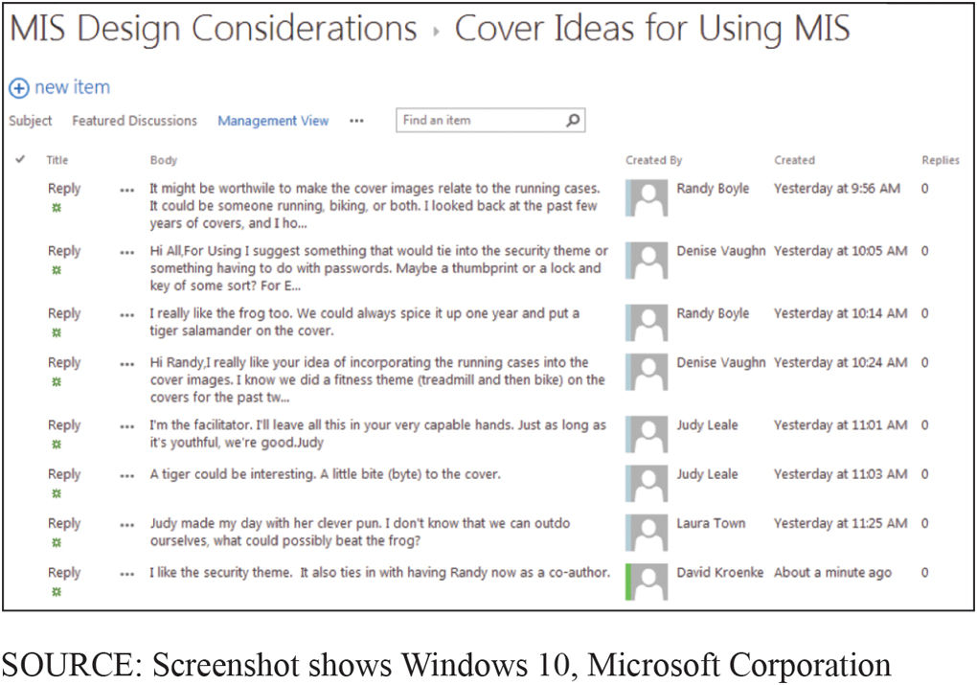
Example Discussion Forum
CE 10-2 How can you use collaboration tools to improve team communication?
Figure C E 10-5 Example Discussion Forum

Slide 9
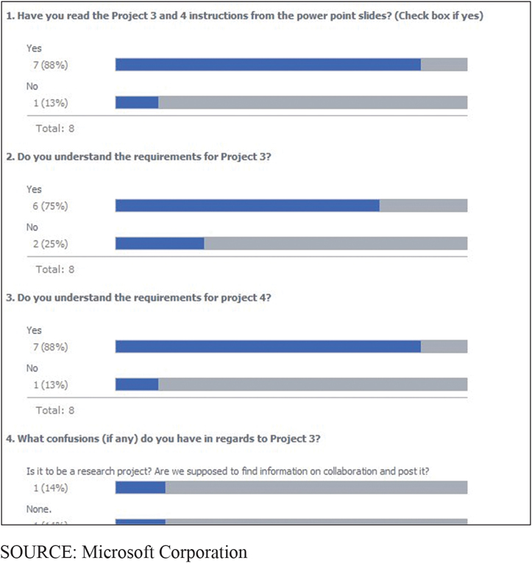
Team Surveys
CE 10-2 How can you use collaboration tools to improve team communication?
Figure C E 10-6 Example Survey Report
Notes:
Ex: SurveyMonkey.com
Effective way to obtain team opinions; they are generally easy to complete, so most team members will participate.

Slide 10
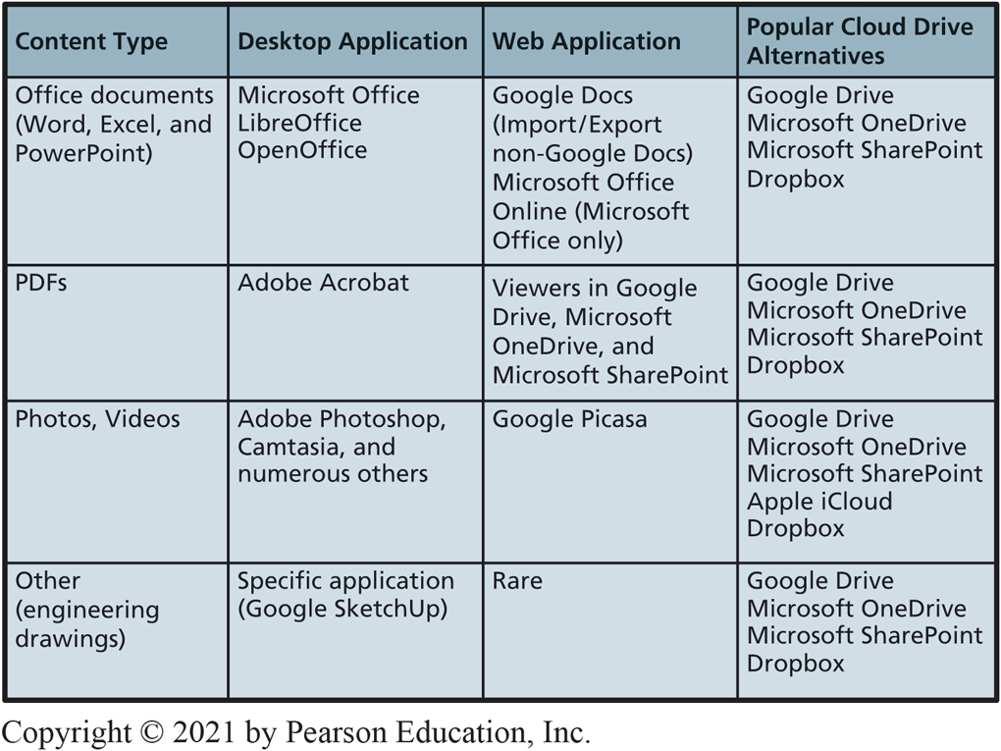
Using Collaboration Tools to Manage Shared Content
CE 10-3 How can you use collaboration tools to share content?
Figure C E 10-7 Content Applications and Storage Alternatives
Notes:
The applications a team uses and the means by which they share data depend on the type of content.

Slide 11
Shared Content Using Google Drive
CE 10-3 How can you use collaboration tools to share content?
Google Drive:
Free, virtual drive in cloud to create folders and store files
Make documents available to others by entering email addresses or Google accounts
With Google account:
Simultaneously see and edit documents
Merge users’ activities into single document
Track document revisions; brief summaries of changes made

Slide 12
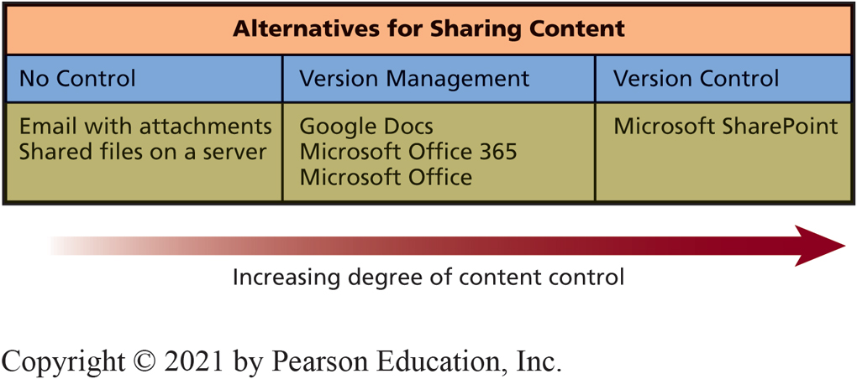
Collaboration Tools for Sharing Content
CE 10-3 How can you use collaboration tools to share content?
Figure C E 10-8 Collaboration Tools for Sharing Content
Notes:
Iteration and feedback depend on sharing project data (documents, illustrations, spreadsheets, and other data), and project metadata (tasks, schedules, and budgets). Choice of system for sharing content depends on degree of control desired.

Slide 13
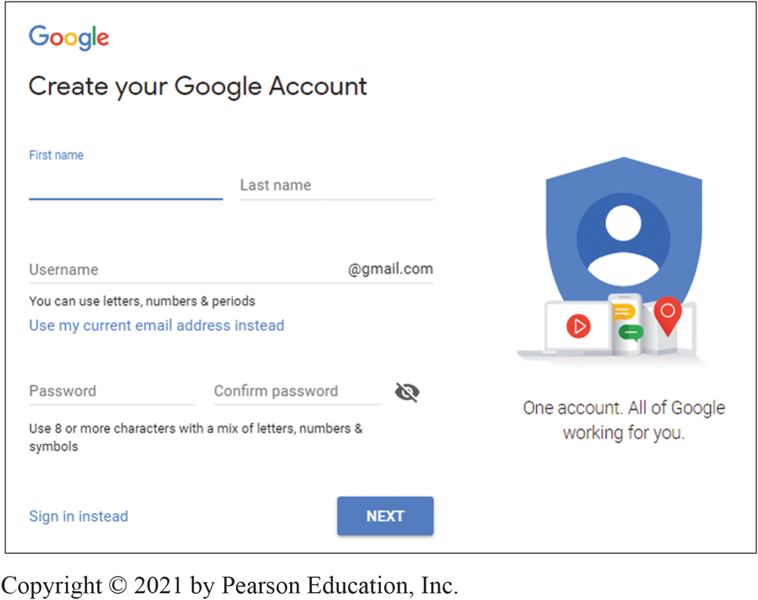
Shared Content with Version Management on Google Drive
CE 10-3 How can you use collaboration tools to share content?
Figure C E 10-9 Form for Creating a Google Drive Account
Source: Google and the Google logo are registered trademarks of Alphabet Inc., Used with permission.
Notes:
Form for creating a Google Drive account.

Slide 14
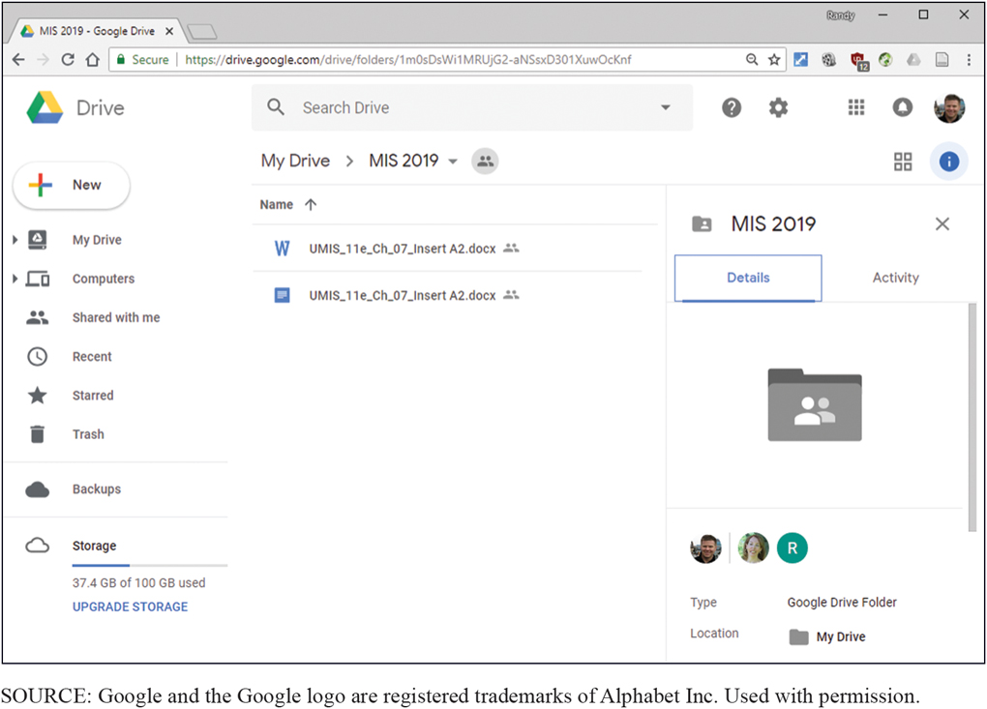
Available Types of Documents on Google Drive
CE 10-3 How can you use collaboration tools to share content?
Figure C E 10-10 Available Types of Documents on Google Drive

Slide 15
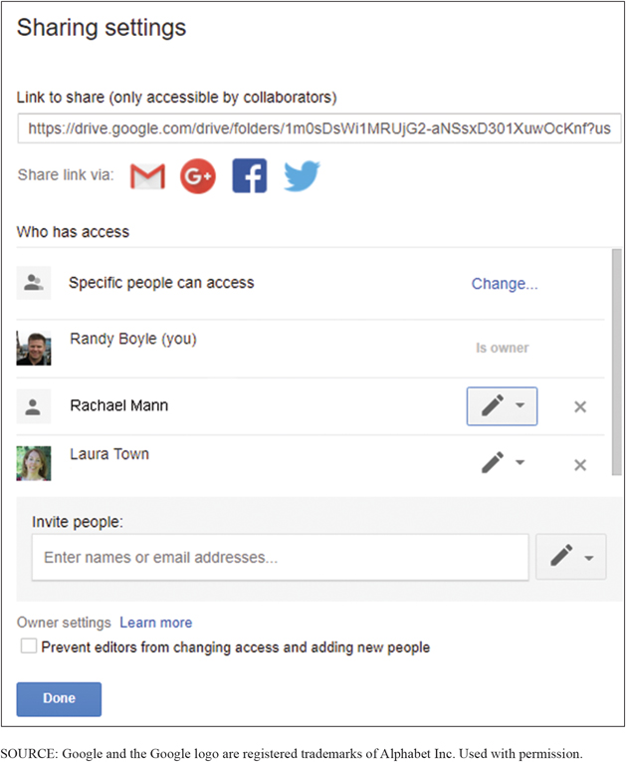
Document Sharing on Google Drive
CE 10-3 How can you use collaboration tools to share content?
Figure C E 10-11 Document Sharing on Google Drive
Notes:
Google Drive is a free service that provides a virtual drive in the cloud into which you can create folders and store files.
You can make documents available to others by entering their email addresses or Google accounts. Those users are notified that the document exists and are given a link to access it.

Slide 16
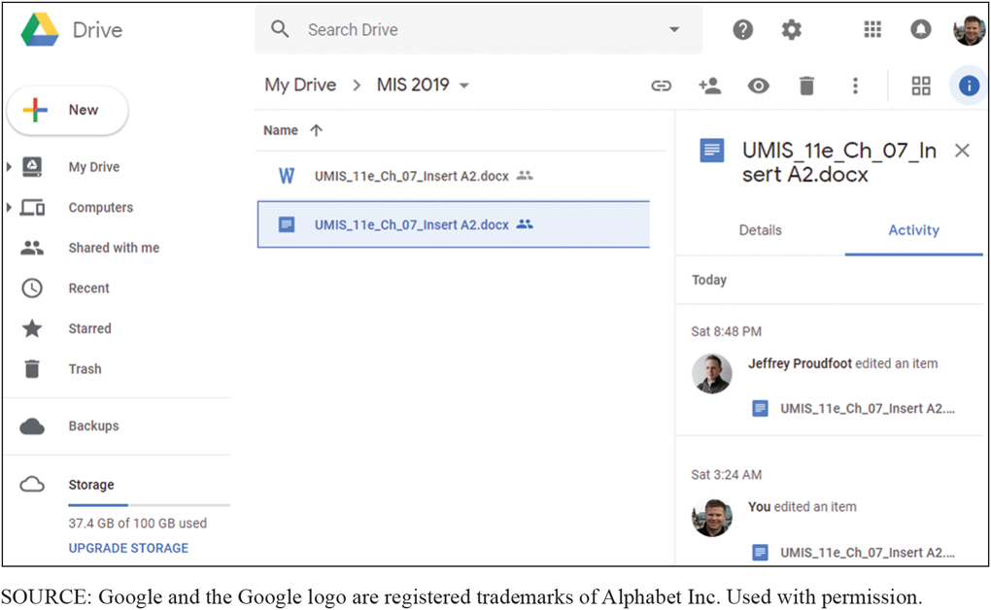
Example of Editing a Shared Document on Google Drive
CE 10-3 How can you use collaboration tools to share content?
Figure C E 10-12 Example of Editing a Shared Document on Google Drive
Notes:
If invited guests have a Google account, they can edit a document; otherwise they can just view it.

Slide 17
Shared Content with Version Control
CE 10-3 How can you use collaboration tools to share content?
Version control involves one or more capabilities.
User activity limited by permissions.
Document checkout.
Version histories.
Workflow control.
Notes:
Version management systems improve tracking of shared content and potentially eliminate problems caused by concurrent document access. They do not provide version control, or workflow control.

Slide 18
Microsoft Sharepoint
CE 10-3 How can you use collaboration tools to share content?
Large, complex, very robust application for all types of collaboration.
Used by thousands of businesses
SharePoint skills in high demand.
Install on company Windows servers or access it over Internet using SharePoint Online.
Notes:
SharePoint is a large, complex, and very robust application for all types of collaboration. It has many features and functions, including all of those just listed. It also contains features for managing tasks, sharing non-Office documents, keeping calendars, publishing blogs, and many more capabilities.

Slide 19
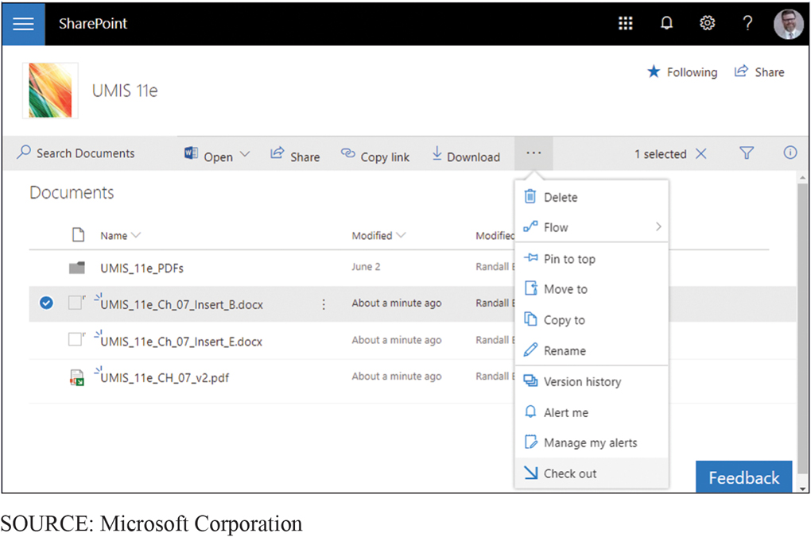
Checking Out a Document
CE 10-3 How can you use collaboration tools to share content?
Figure C E 10-13 Checking Out a Document
Notes:
With version control applications, document directories can be set up so users can check out documents to modify them. When a document is checked out, no other user can edit it. Once document has been checked in, other users can access it.

Slide 20
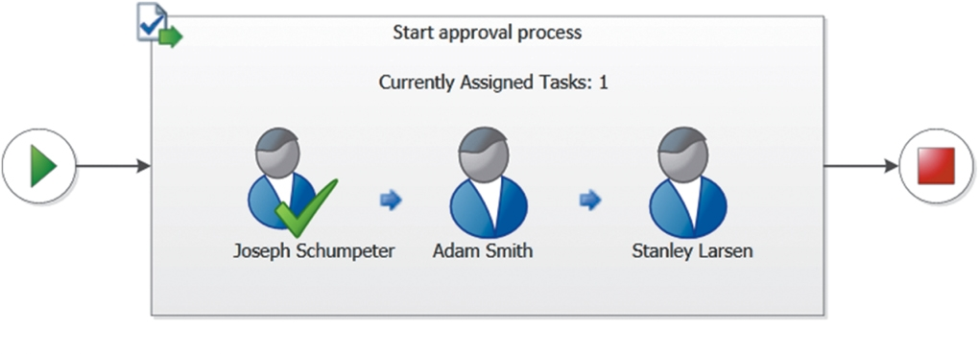
Workflow Control
CE 10-3 How can you use collaboration tools to share content?
Figure C E 10-14 Example Workflow

Slide 21
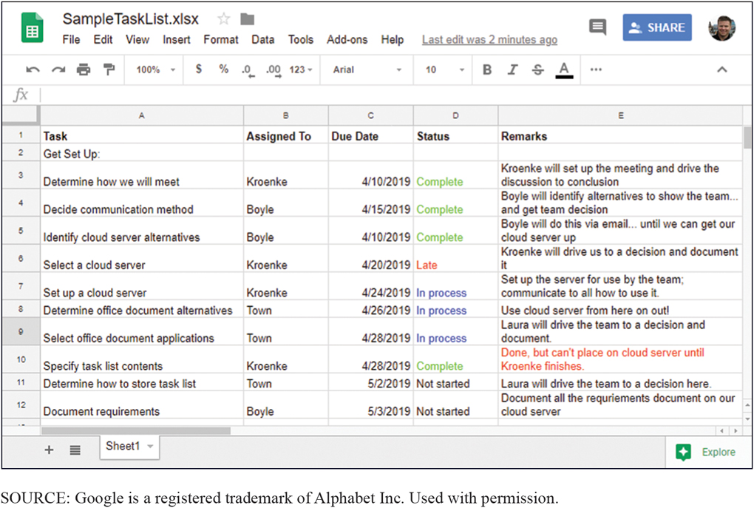
Using Collaboration Tools to Manage Tasks
CE 10-4 How can you use collaboration tools to manage tasks?
Figure C E 10-15 Sample Task List
Notes:
Example of a task list using Google Drive.

Slide 22
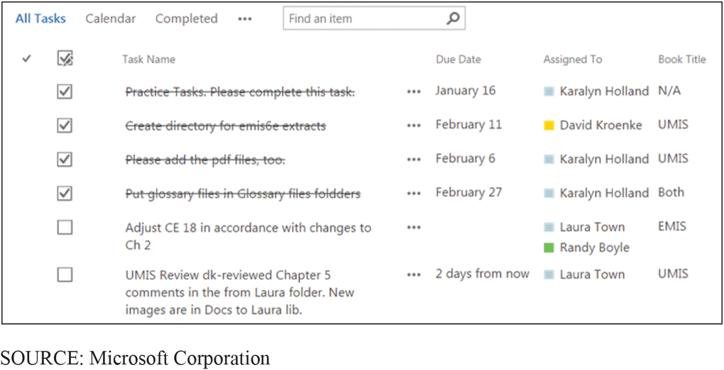
Production Task List in SharePoint
CE 10-4 How can you use collaboration tools to manage tasks?
Figure C E 10-16 Production Task List
Notes:
Good project managers make sure that every team meeting ends with an updated list of tasks, including who is responsible for getting each task done and the date by which he or she will get it done.
One person should be made responsible for accomplishing a task.
Descriptions need to be specific and worded so it is possible to decide whether the task was accomplished.

Slide 23
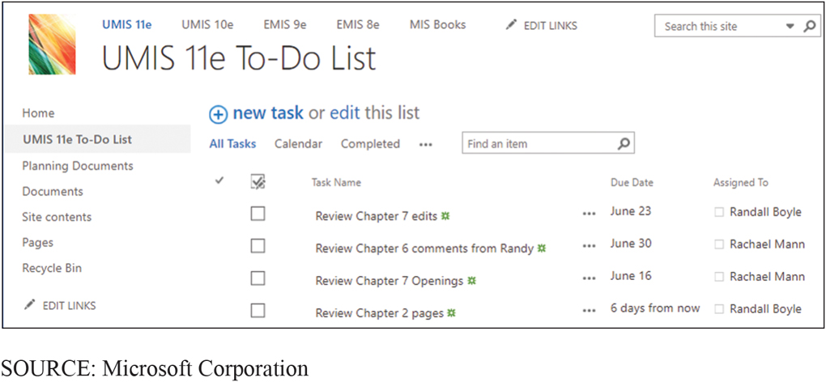
To-Do List in SharePoint
CE 10-4 How can you use collaboration tools to manage tasks?
Figure C E 10-17 To-Do List

Slide 24
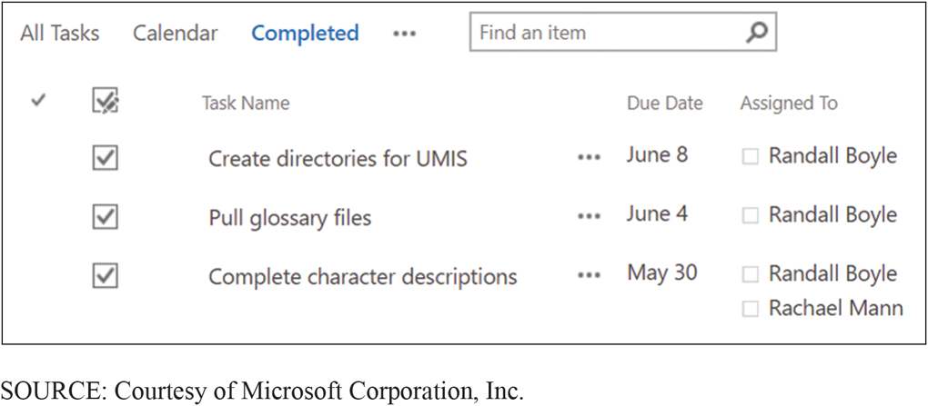
Completed Tasks in SharePoint
CE 10-4 How can you use collaboration tools to manage tasks?
Figure C E 10-18 What We’ve Done So Far

Slide 25
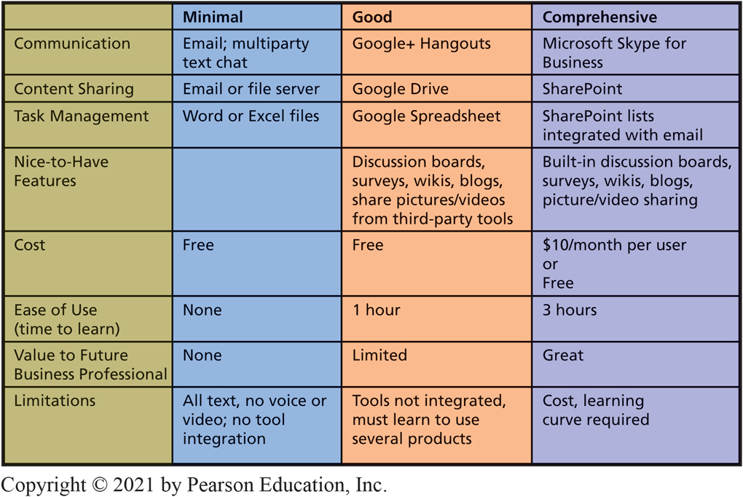
Three Collaboration Tool Sets
CE 10-5 Which collaboration information system is right for your team?
Figure C E 10-19 Three Collaboration Tool Sets
Notes:
Figure CE10-19 summarizes three different sets of collaboration tools that you might use.

Slide 26
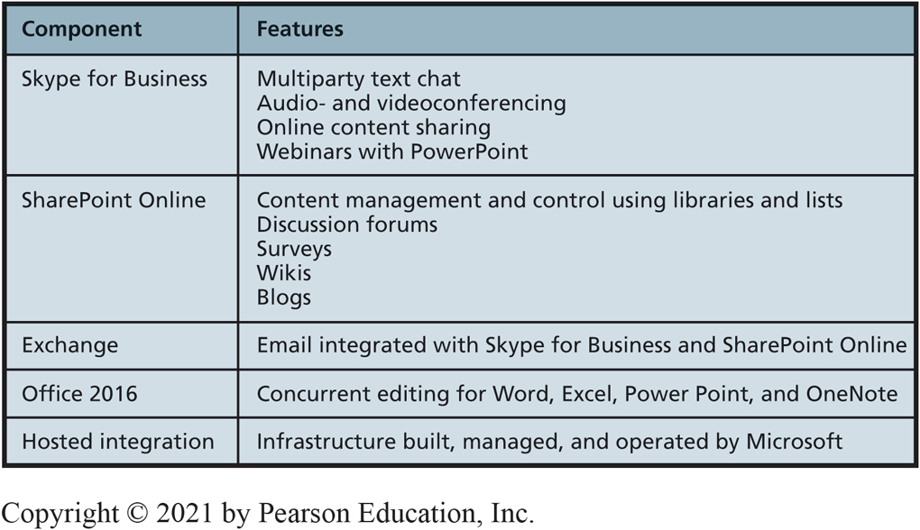
Office 365 Features You Need for the Comprehensive Tool Set
CE 10-5 Which collaboration information system is right for your team?
Figure C E 10-20 Office 365 Features You Need for the Comprehensive Tool Set
Notes:
What can you do with Office 365?
Share desktops, programs, community whiteboard
Do online surveys
Video meetings
Conduct Webinars

Slide 27
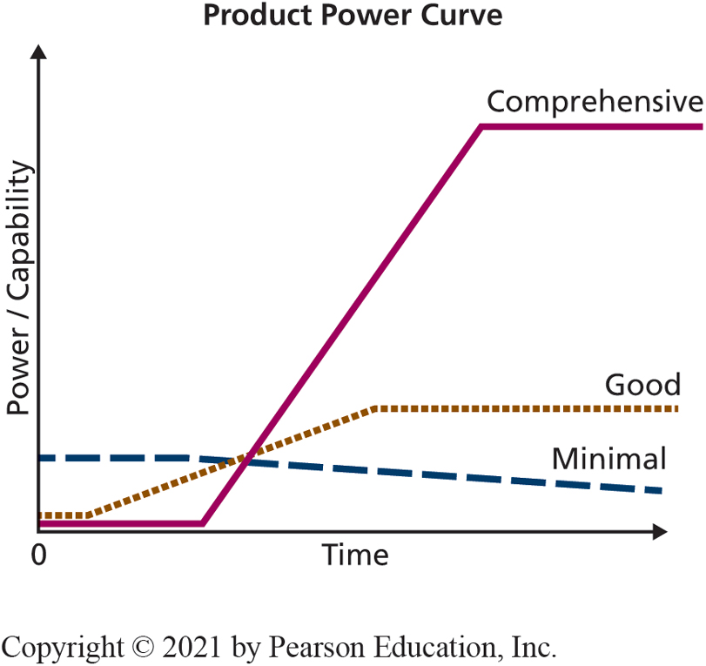
Evaluating Learning Time
CE 10-5 Which collaboration information system is right for your team?
Figure C E 10-21 Product Power Curve
Notes:
Minimal set has no value to you as a future professional and contributes nothing to your professional competitive advantage.
Good set has some limited value; there are organizations that use Google Drive and Skype.
Comprehensive has potential to give you a competitive advantage.

Slide 28
Don’t Forget Procedures and People!
CE 10-5 Which collaboration information system is right for your team?
Data component up to you.
Metadata for project management demonstrates your team practiced iteration and feedback.
Team needs to agree on tools to use.
Train team members in the use of tools.
Create special jobs or roles needed.

Slide 29
Active Review
CE 10-1 What are the I S requirements for student project collaborations?
CE 10-2 How can you use collaboration tools to improve team communication?
CE 10-3 How can you use collaboration tools to share content?
CE 10-4 How can you use collaboration tools to manage tasks?
CE 10-5 Which collaboration information system is right for your team?

Slide 30

Copyright

